Slide 1
Conditional Formatting Tricks with Power BI
Pragati Jain, Data Platform MVP

Slide 2
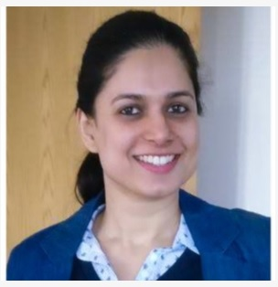








Pragati Jain
Microsoft Data Platform MVP
Superuser at Microsoft Power BI Community
10+ years of industry experience
Senior Consultant at Avanade, London
Fun Fact About Me:
I am a painter and proudly call myself ‘TechieArtist’ 😊

Slide 3
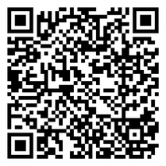
Donate Today!
https://otsn.live/M365CHI-CFFDonation

Slide 4









Massive Thanks to Our Sponsors!
Gold Partner
Community Partners
Silver Partners
M365 Chicago is an OTSN Conference
Chicago Power Platform Users Group
M365 Friday Cabo San Lucas

Slide 5
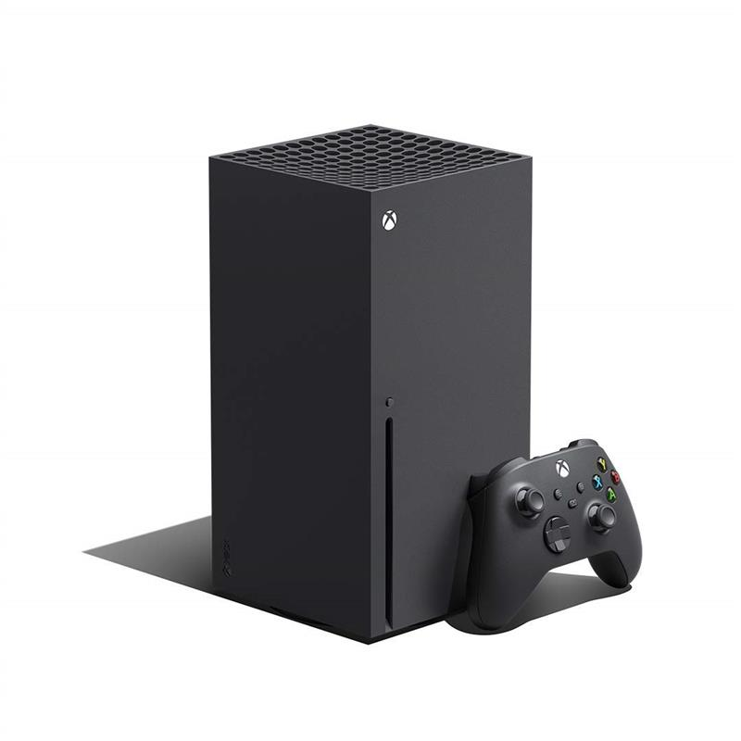


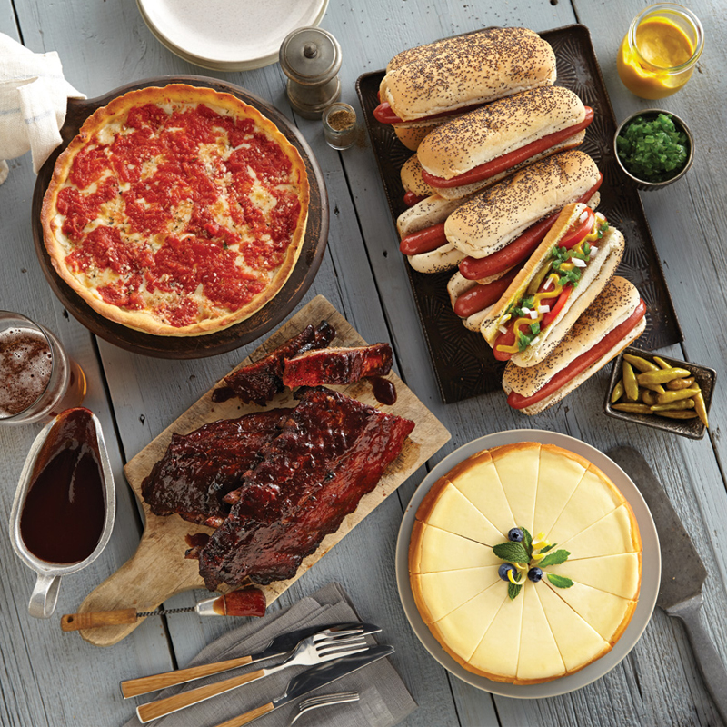
Raffles and Giveaways
$100 Gift Card for Opt-in Raffle
5 Winners
$250 Gift Card for Partner Raffle 2 Winners
Xbox One for Attendee Opt-in Raffle
1 Winner
Chicago Prize Pack Twitter Giveaway
1 Winner
TWITTER GIVEAWAY!!!
Tweet about the conference using #M365CHI22 for a chance to win a Chicago Prize Pack. One Winner selected at random!
OPT-IN REGISTRATION RAFFLE Did you opt-in to talk to our partners during registration? Thank you! Join us in the General Channel at 5:50 to see if you won an Opt-In Raffle prize!
PARTNER RAFFLE Please, visit our Partners! While you’re there, ask for their Special Phrase and gain an entry for our Partner Raffle prize!
Submit your Partner Raffle entries to https://otsn.live/M365Chi-SponsorContest

Slide 6
Agenda (One Slide, All Demo Session)
In this session we will be exploring few ways of applying conditional formatting to a report in Power BI at data level and visual level.
Data Level Conditional Formatting
Default formatting options:
Background colour formatting
Font colour formatting
Data bars
Icon formatting
Custom measure
Custom icons
Visual Level Conditional Formatting
Conditional titles on visuals based on slicer selections
Conditional Data Bars on visual
Conditional colours on a Map
Heatmap look on a matrix visual

Slide 7

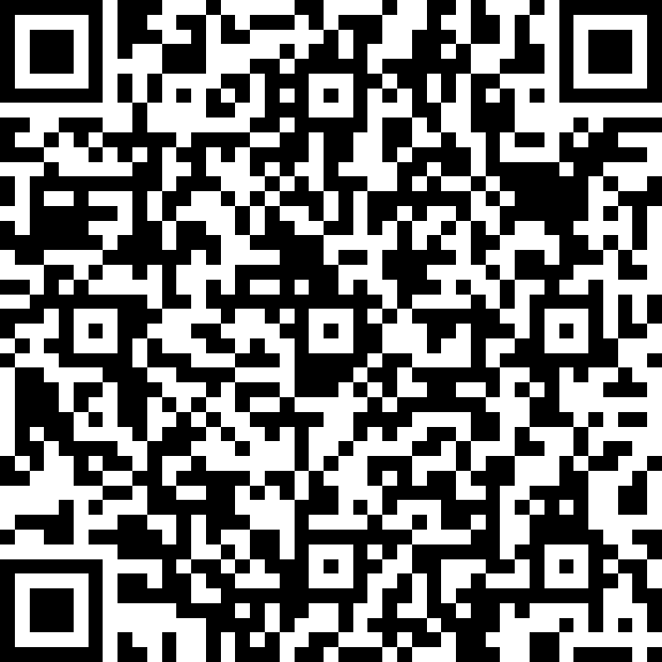
Help Us Improve Our Conference! Fill out a short speaker survey for each session you attend AND for the conference, overall!
https://otsn.live/M365CHI-Feedback
https://otsn.live/M365CHI-Feedback

Slide 8

Thank you and Happy to answer any questions.

